Slide 1
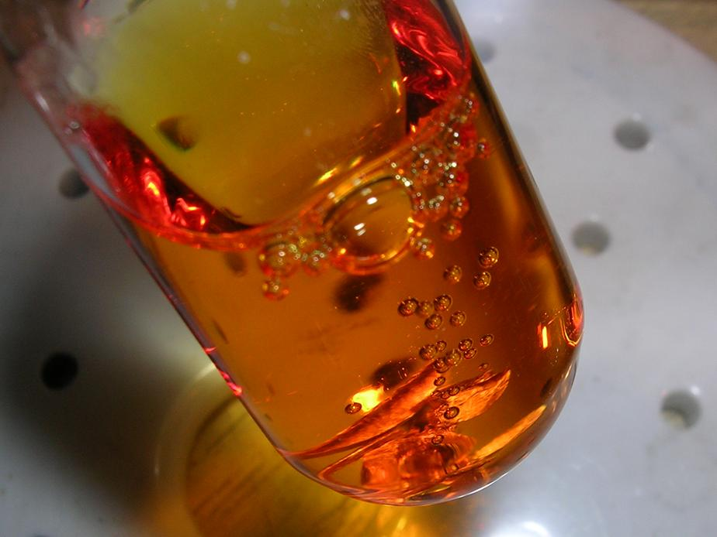
Aqua Regia and Nitric acid Safety
Royal Water

Slide 2
NFPA 704
Flash points:
4: < room temp
3: <38 °C
2: <93 °C
1: > 93°C
0: non-flammable
Stability
4: May detonate
3: Shock/heat sensitive
2: Violent chemical change
1: Unstable if heated
0: Stable
Standard system for identification of hazards of materials for emergency response -National Fire Protection Association
Health Risk
4: Deadly
3: Extreme danger
2: Hazardous
1: Slightly hazardous
0: Non-hazardous
Fire Hazard
Health Hazard
Instability Hazard
Specific Hazard
Specific Hazard
ACID
ALK (alkaline)
COR (corrosive)
OX (oxidizer)
Radiation
Water reactive W

Slide 3
Aqua Regia
3:1 mixture of conc. HCl and HNO₃
Spill >200 mL outside of hood requires lab evacuation and EHS response.
Mixture decomposes rapidly generating gasses
HNO₃ + 3 HCl → NOCl_{(g)} + Cl_{2(g)} + 2 H₂O
2 NOCl _{(g)} → 2 NO _{(g)} + Cl_{2(g)}
2 NO_{(g)} + O_{2(g)} → 2 NO_{2(g)}
Metals are fully oxidized generating soluble chloride salts
Pt_{(s)} + 2 HNO₃ + 4 HCl → PtCl₄ + NO_{2(g)} + NO_{(g)} + 3 H₂O
Sn_{(s)} + HCl + 2 HNO₃ → SnCl₄ + NO_{2(g)}+ NO_{(g)} + 3 H₂O
2 Au_{(s)} + 4 HNO₃ + 8 HCl → 2 HAuCl₄ + 3 NO_{2(g)} + NO_{(g)} + 5 H₂O
Aqua regia added to Zn⁰ powder
https://www.youtube.com/channel/UC9XDwNjdmbcC7i_NBKhLptQ

Slide 4
Concentrated Nitric Acid
Subject to thermal and light decomposition
Store in a cool dark place
4 HNO₃ → 2 H₂O + 4 NO₂(g) + O₂(g)
2 HNO₃ ⇌ NO₂⁺ + NO₃⁻ + H₂O
Dissolved NO₂(g) colors HNO₃ yellow and gives off red-brown vapors
Oxidizing agent reacts with cyanides, carbides, and metallic powders explosively and with organic compounds violently.
C_{x}+ 2 HNO₃ → x CO_{2(g)} + 2 NO_{2(g)} + H₂O
Aromatic compounds are easily nitrated via electrophilic aromatic substitution (eg. TNT)
Carbonyl compounds are readily nitrated at the α-position via the enol
Conc. HNO₃ and THF
https://www.youtube.com/channel/UC3_tFLTJfjUrYNCdD-PLbrA

Slide 5
Corrosive Acids
Damage skin, eyes, and respiratory tract.
Acid hydrolysis with proteins (amides) and fats (esters) decomposes living tissue
Only thick butyl rubber gloves can protect from corrosive acids
Conc. HNO₃ reacts with keratin staining skin yellow, then orange when neutralized.
Standard first-aid treatment for spills on the skin is irrigation with large quantities of water for 15 min.
Contaminated clothing is removed immediately and the underlying skin is washed thoroughly.
Fuming HNO₃ to lab gloves
https://www.youtube.com/channel/UCFhXFikryT4aFcLkLw2LBLA

Slide 6
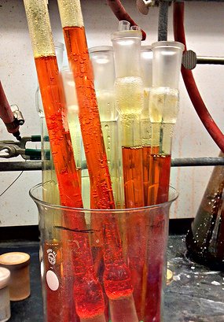
Aqua Regia SOP
Preparation
Make the minimum amount and use only if necessary
Generate and use exclusively in the hood.
Do not re-use or store.
Use
Carefully pour or pipet into glassware to be cleaned.
Leave vessels in back of hood away from other materials.
Do not mix with or place near bases or organic materials.
Do not cap or seal containers.
Let fully react before disposal.
Disposal
Add spent acid to an empty blown dry glass bottle with a mixed waste label with all contents including heavy metals listed and spelled out.
Or use saved concentrated HCl glass bottles to prevent any incompatibility.
Store in the corrosives or waste cabinets in a secondary container.
Do not fully tighten the cap immediately upon addition or when in doubt.

