Slide 1
Cyanides
Safety and Waste Management

Slide 2
HCN producing materials
Benzyl cyanides (phenylacetonitrile)
Readily hydrolyzed under acidic conditions (restricted)
Found in plant sources – cyanogenic glycosides
Cyanide Salts: HCN pk_{a}~ 11
KCN, NaCN, LiCN, MgCN₂, CuCN, AgCN, NR₄CN, ZnCN₂
Incompatible with all acids and strong oxidants
Stored in a dry place away from other materials.
Cyanogens
(CN)₂ undergoes reduction to cyanide
Volatile cyanogen bromide (Br-CN) undergoes substitution with water.
Decomposition of ferricyanides and ferrocyanides
Water, acids, over time
6 HCl + K₃[Fe(CN)₆] → 6 HCN + FeCl₃ + 3 KCl
Combustion under O₂ deficiency
Plastics derived from PAN - synthetic wool/furs and fabrics, “carbon fibers.”

Slide 3
Cyanide Toxicity
Cyanide salts such as KCN are hydrolyzed to HCN by stomach acid.
LD₅₀= 3-8 mg/Kg
Blood concentration: >3 mg/L death (~15 mg).
Cyanide inhibits cytochrome oxidase enzyme preventing cells from using oxygen
Exposure Symptoms: dizziness, headache, nausea and vomiting, rapid heart rate and breathing. Low blood pressure
Fatality cause by loss of consciousness and respiratory failure followed by convulsions.
~40% of people can smell the bitter almond scent of cyanide
Compound Interest: http://www.compoundchem.com/2015/02/26/cyanide/
Notes:
is the inability of cells to take up or use oxygen from the bloodstream. a reduction in ATP production by the mitochondria due to a defect in the cellular usage of oxygen.^{[2]}m

Slide 4
Response and Treatment
Speed is critical. Avoid mouth-to-mouth resuscitation and contact with vomit.
Supplemental O₂ to prevent histotoxic hypoxia.
Cyanide has a short half life and is converted to thiocyanate in the body.
Not much can be done to detect cyanide poising in time.
Hydroxocobalamin (Cyanokit) antidote is administered by a medical professional via IV and converts cyanide to harmless cyanocobalamin.
Antidotes are in short supply do to abuse of amyl nitrite, short shelf lives, slow reaction time, route of administration, and high cost.

Slide 5
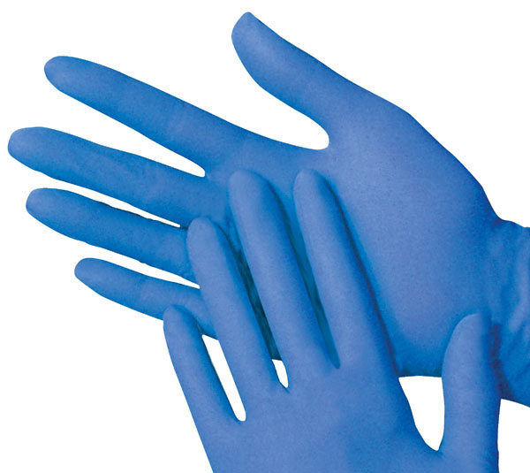
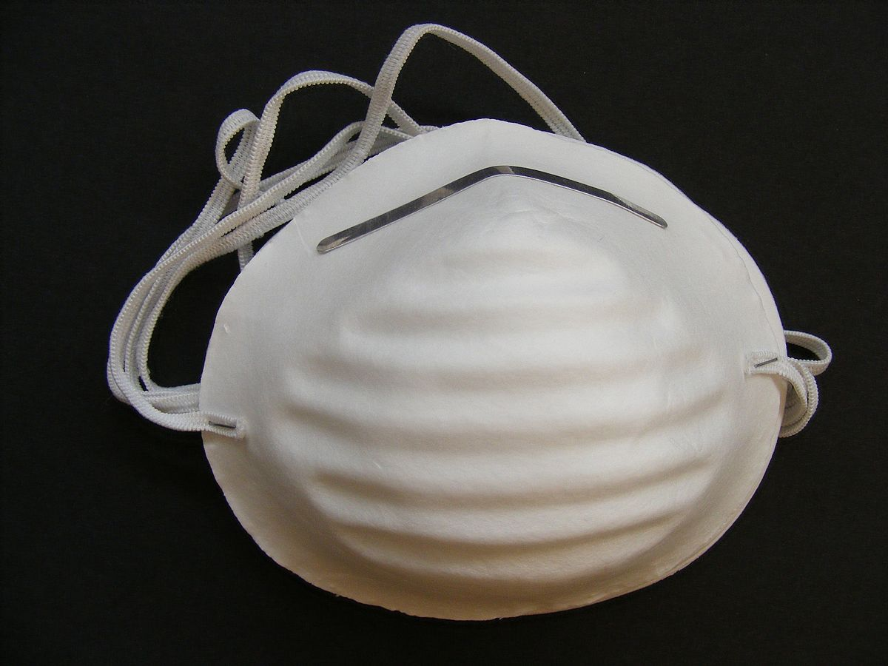
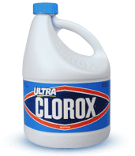
Safe Handling, Cleanup, and Disposal
Transport cyanides in a secondary container
Use, weigh and workup exclusively in the hood
Wear a mask if massing solids outside the hood
Double glove when handling and change gloves after clean-up.
Workup reactions with a basic solution; pH 10+ solution
Do not quench with acids, water/brine, concentration on the rotovap… etc. no matter what the procedure says.
Use basic dilute bleach (~10%) for cleaning contaminated materials and equipment.
KCN +NaOCl → KOCN +NaCl
Waste and empty reagent bottles must be disposed of separately as hazardous waste.
Leave for pick up – do not dispose with regular garbage or recycling
Collect all cyanides from cleaning, workup solutions and solid waste in a plastic bottle with a highly basic solution of KOH.

