Slide 1
Hazardous Gases
compressed gas cylinders

Slide 2
Hazardous gases
Toxic gases such as CO, NH₃ pose risk via inhalation.
No pressure release valves
Reactive gases like HCl, NO, and NO₂ make corrosive acids in air.
Metal hydride gases such as B₂H₆ are highly toxic and pyrophoric.
Decompose generating large amounts of H₂ gas, over-pressurizing tanks.
Long term storage problems.
Flammable gases– H₂ and acetylene
Lighter than air, wide flammable ranges, very low ignition (static spark)
Unstable gases decompose exothermically– acetylene, NO, NO₂
Chemical asphyxiant (TOXIC)– HCN, H₂S, CO
Inert gases - asphyxiate by displacing oxygen (Ar, N₂, He, CO₂)
Have pressure relief valves
Flammable Gas
2
Non-Flammable
Gas
2
Inhalation
Hazard
2
Oxygen
2
Notes:
Nitric oxide or nitrogen dioxide
Hydrogen disulfide

Slide 3
Gas Cylinder Caps
Always have cylinder cap in place unless in use!

Slide 4
Compressed Cylinders
Storage
Secure all cylinders to a wall in designated locations using a strap.
Labels on cylinder should be visible where stored.
Full, in use, empty tags
Segregate full and empty cylinders and keep incompatible cylinders >20 ft apart.
eg oxygen gas and other flammable gasses
Do not store cylinders >3 years.
FULL
IN USE
EMPTY
Oxygen
2

Slide 5
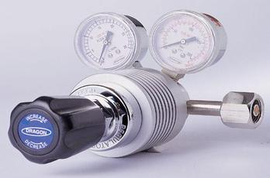
Compressed Cylinders
Usage
Get trained on the specifics of using a new regulator or gas.
Be aware of approved regulator types, required monitors, PPE and storage when purchasing and setting up.
(Get help from supplier eg Airgas)
Use the buddy system when changing hazardous gas cylinders.
Always use a proper carrier or cart with a chain.
Do not use Teflon tape or thread sealant on cylinders.

