Slide 1
Safety Moment
Vacuum Pump

Slide 2
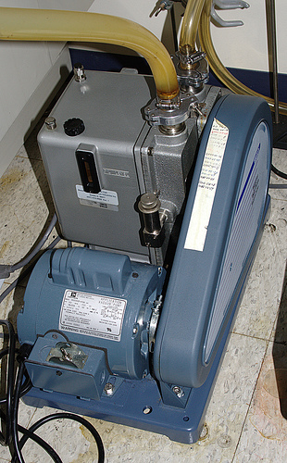
Vacuum Pump Maintenance
When performing maintenance on a vacuum pump such as a belt change, turn the pump off, and unplug it.
Let the pump properly cool before performing maintenance.
When turning the pump back on, be sure nothing is in the way of the belt including your hands.
Belt covers help prevent anything form getting caught in the belt and also prevent oil spray.
When changing your pump oil, force old oil out and collect as waste, add new oil to the intake valve, and force it through until the oil runs clean.
Do not use solvent for this flush!
Organic solvents are highly flammable in a moving hot pump.
Chlorinated solvents are bad for the mechanism.

Slide 3
Safety Scenario
Hood Fire

Slide 4
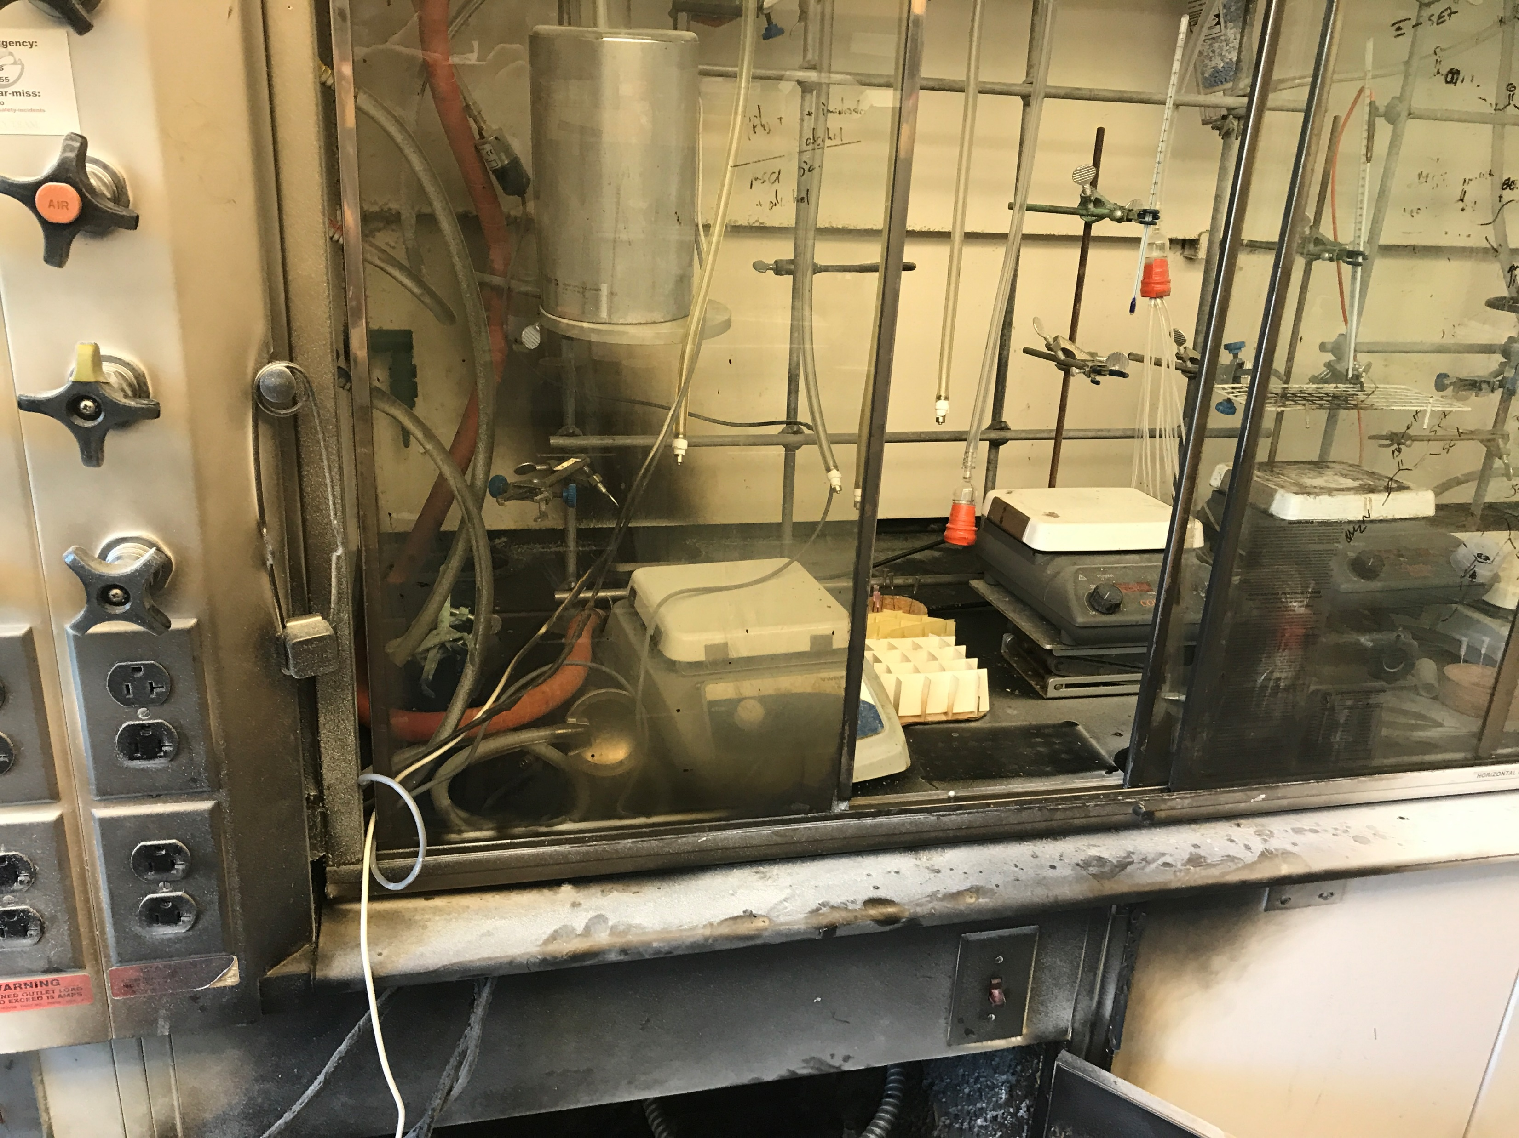
Safety Scenario
You walk into lab and over to your hood when you notice your labmates hood looks like this!
What do you do?!

Slide 5
Safey Scenario
Note: of the most important things to do here are to ensure your labmate is ok and not hurt somewhere, block off the area, and to call the fire department to ensure no fire is continuing to burn in the back of the walls behind the hood and that there is no further threat of fire.
Shutting off power to the hood form a remote area such as a fuse box would be a great option since the source of the fire is unknown.

Slide 6
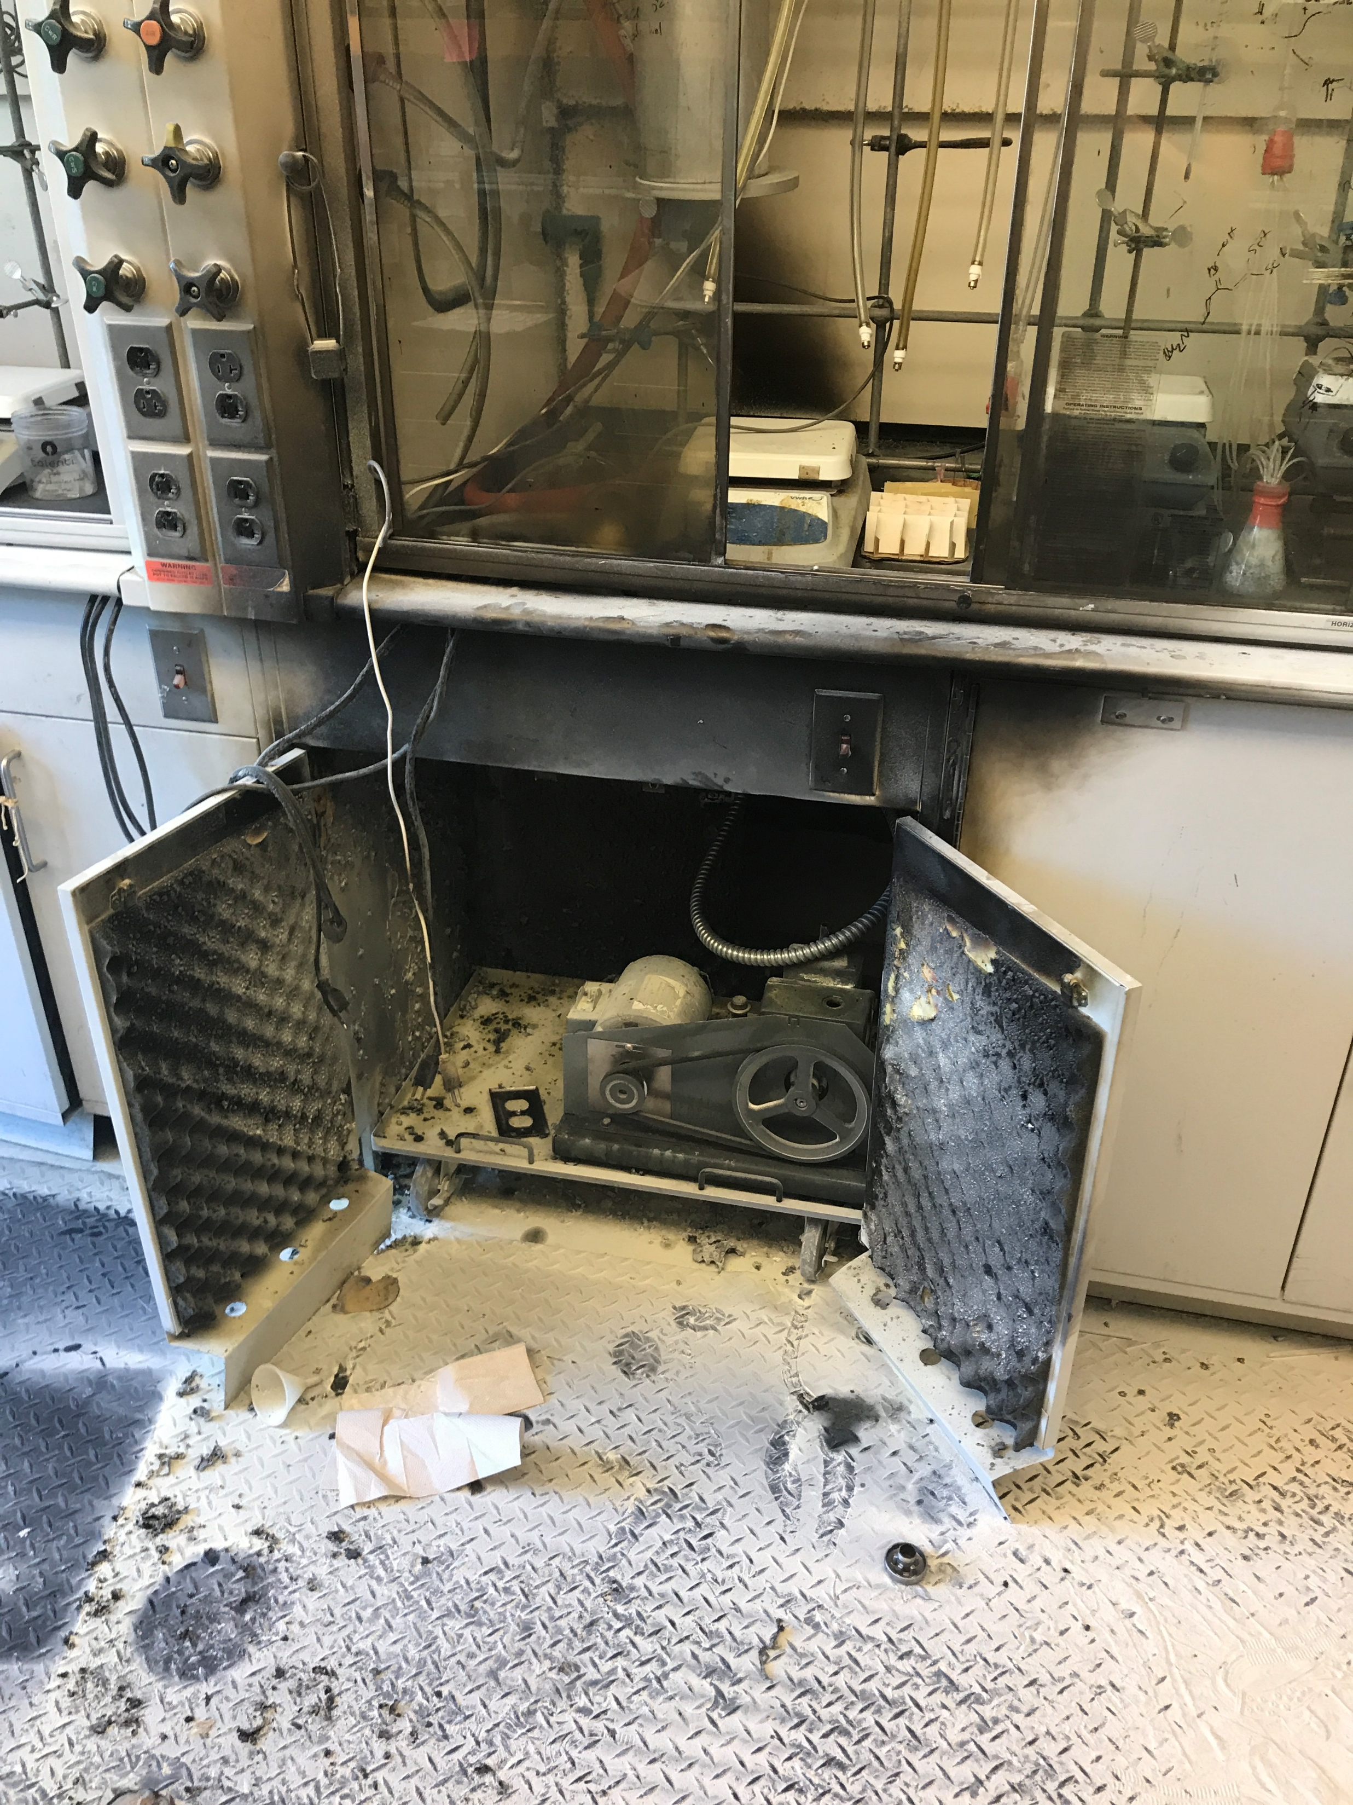
Safety Scenario
Upon further inspection of the scene you realize a fire extinguisher was used and identify the pump as a source of the fire. What else should you do? What might have happened here?

Slide 7
Safety Scenario
It is important to report any accident to EHS that results in fire/property damage.
Additionally, if a fire extinguisher is used, they make a huge mess and need to be cleaned up properly by EHS or a contracting company they employ and also need to be replaces ASAP.

