Slide 1
Safety Moment
Lecture Bottle Safety

Slide 2
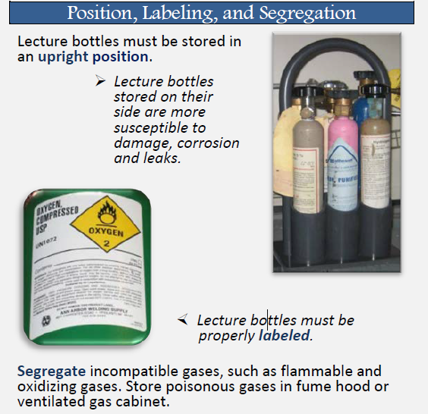
What are lecture bottles?
Lecture bottles are small compressed gas cylinders, typically 2-3 in in diameter.
They are non-refillable and purchased outright from the vendor.
Lecture bottles are the University's responsibility to properly dispose. They are useful when particularly hazardous gasses (health hazard 3-4) or expensive analytical standards are needed.
Common lecture bottle gasses: 1,3-butadiene, acetylene, low boiling amines, carbon monoxide, butenes, hydrogen halides and dihalide gasses.

Slide 3
How are they stored?
Regulators must be removed during storage and the cap must be secured on the cylinder. Must be stored upright.
Acid cylinders have a short shelf life due to corrosion, the worst of these acids being HF which must be disposed of within 2 years.

Slide 4
How are they used?
Properly secure upright in a fume hood.
Lecture bottles typically use universal threads and valves so labeling to prevent gas mixing is crucial.
A regulator of a corrosive gas should be purged in the hood so residual gas is expelled. The regulator can be flushed with dry N₂ gas for 30 minutes before storage.
https://ehs.ucr.edu/hazardousmaterials/lecture%20bottles%20fact%20sheet.pdf

