Slide 1
Safety Scenario
CO poisining

Slide 2
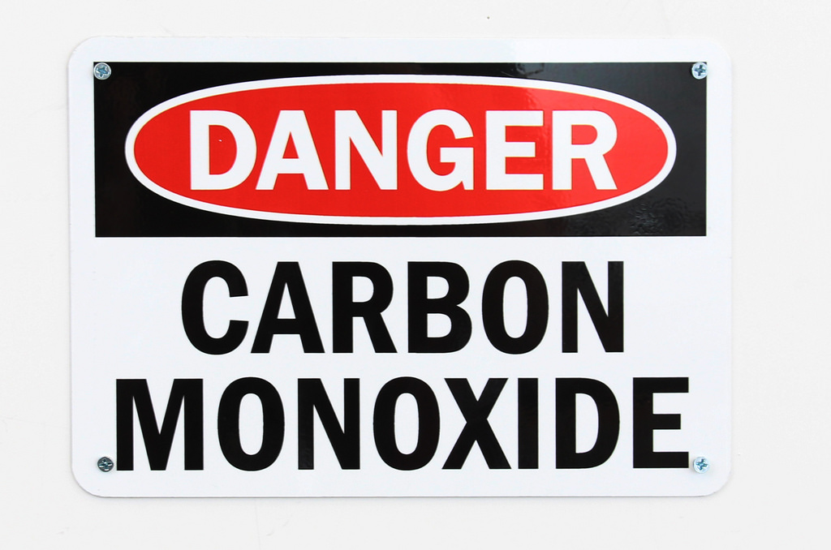
Safety Scenario
Your lab mate looks pale and expresses that he/she is not feeling very well.
Shortly before that, he/she was doing CO additions.
What shold you do?

Slide 3
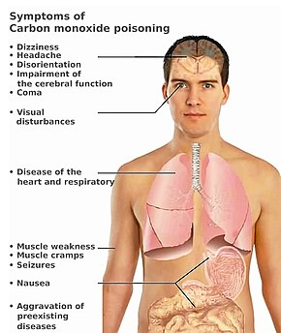
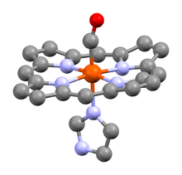
Symptoms
CO binds ~200 times stronger than O₂
Half life is 4-6 hours under normal conditions
A heme unit of human carboxyhaemoglobin, showing the carbonyl ligand (CO) at the apical position, trans to the histidine residue. https://en.wikipedia.org/wiki/Carboxyhemoglobin

Slide 4
Course of action
CO Poising Prevention
Keep CO detectors near CO tanks
Ensure chemistry is done in a properly ventilated fume hood
Work with other people around
Potential Poising Response
Remove victim from the environment to fresh air
Call 911
Pay close attention to their vital signs
Use CPR if necessary

