Slide 1
Safety Scenario
Solvent Fire

Slide 2
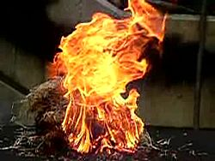
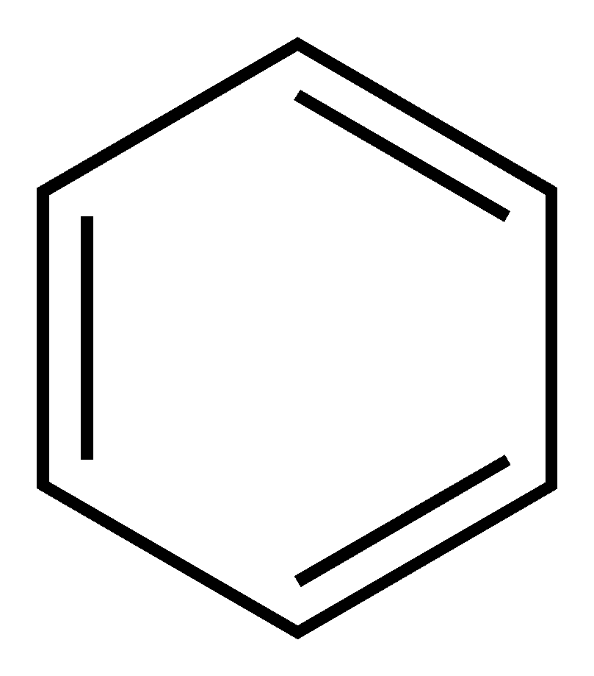
Safety Scenario
Graduate student was working in hood when he/she picked up a bomb flask containing benzene being dried over sodium benzophenone, which inexplicably cracked. The solution immediately ignited and some spilled into a water bath near it.
What would you do in this situation?

Slide 3
Safety Scenario
The graduate student immediately dropped the flask and moved away from the fire, quickly shutting the hood sash and pressing the emergency exhaust. Students then successfully put out the ensuing hood fire with a yellow Class D fire extinguisher. EHS was alerted and a fire marshal came. Nobody was injured and there was no serious damage. The fire extinguisher was replaced and the areas was cleaned by an EHS crew.
Some takeaway messages:
Students were calm and followed contingency procedures correctly to avoid injury
Not all lab accidents are the result of lapses or mistakes!
Unpredictable accidents can happen at any time – avoid complacency when handling dangerous materials and stay alert
In this scenario, how could the risk of a serious sodium fire be further mitigated?

