Slide 1
Safety Moment
Mercury

Slide 2
Mercury Spills
Mercury bioaccumulates in humans and other animals such as aquatic life and is very dangerous to health.
If Hg is spilled make sure the area is well-ventilated
If large spill, contact EHS for cleanup and block off the area.
If small spill:
Use an index card to gather droplets together, then use pipette to pick up droplets
Place in separate properly labeled waste container
Dispose of the waste via EHS

Slide 3
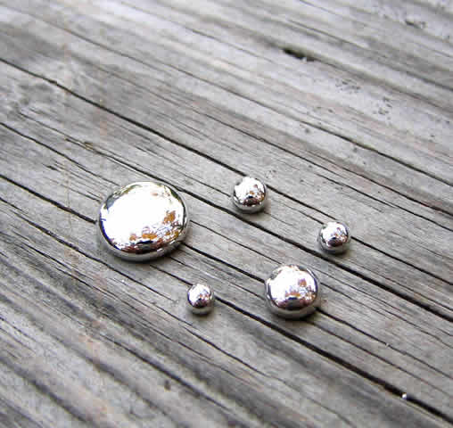
Mercury Spills
Additional considerations:
If spill is on the floor, put bags around feet to prevent getting Hg on your shoes
Keep liquid Hg separate from contaminated items
Place contaminated items (e.g. gloves) in a separate plastic bag for pickup
Do not use a vacuum or broom – doing so can release vapors
EHS will pick up old mercury equipment like thermometers and bubblers to keep mercury devices out of the department.

