Slide 1
Safety Moment
Compressed gas safety

Slide 2
Compressed Gas Safety
Non-flammable, non-toxic gases
Causes asphyxiation by displacing O₂. Can explode if heated.
N₂, Ar, He, CO₂
Flammable gases
Gases or gas mixtures that are ignitable. Lighter than air, low flash point (sensitive to static spark).
CO, H₂, C₂H₂ (acetylene)

Slide 3
Compressed Gas Safety
Toxic/corrosive gases
Harmful/fatal if inhaled or in contact with skin. Chemical asphyxiant.
NH₃, HCl, H₂S, CO
Oxidizing gases
Any gas which causes or contributes to the combustion of other materials; some of these gases decompose exothermically.
O₂, NO, NO₂

Slide 4
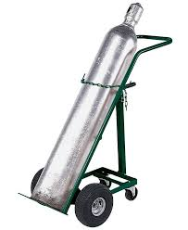
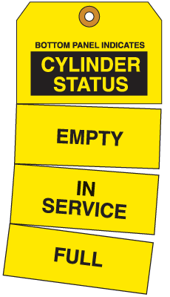
Compressed Gas Safety
When using a cylinder, ALWAYS:
Use a proper carrier or cart with a restraining device
Use the buddy system when changing hazardous gas cylinders
Use an empty, in use, full tag
Use regulators approved for the specific gas you’re using
When using a cylinder, NEVER:
Move more than 5 ft. without a carrier
Use Teflon tape or thread sealant on cylinders
Try to catch a falling cylinder
Get in an elevator with a full/in use cylinder
When storing a cylinder, ALWAYS:
Have a cylinder cap in place unless in use
Secure all cylinders to a wall in designated areas with chains and/or straps
Position tanks so labels are visible
When storing a cylinder, NEVER:
Keep incompatible gases together (e.g. flammable and oxidizing)
Expose the cylinders to corrosive materials
Store cylinders more than 3 years
Expose to temps above 52°C

