Slide 1
Safety Scenario
Pyrophoric materials

Slide 2
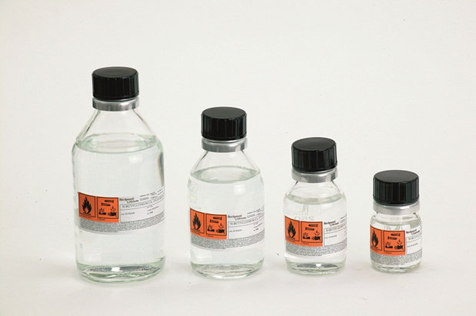
Scenario
You are about to use a bottle of a pyrophoric reagent in your hood. As you remove the cap, the bottle catches fire. What now?
Notes:
Nitric oxide or nitrogen dioxide
Hydrogen disulfide

Slide 3
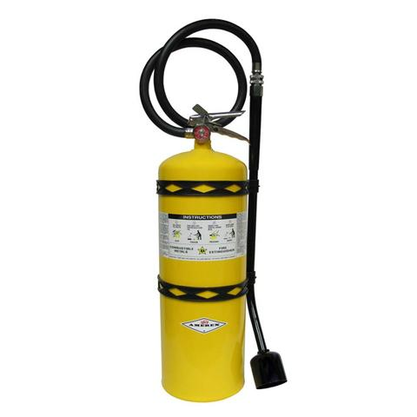
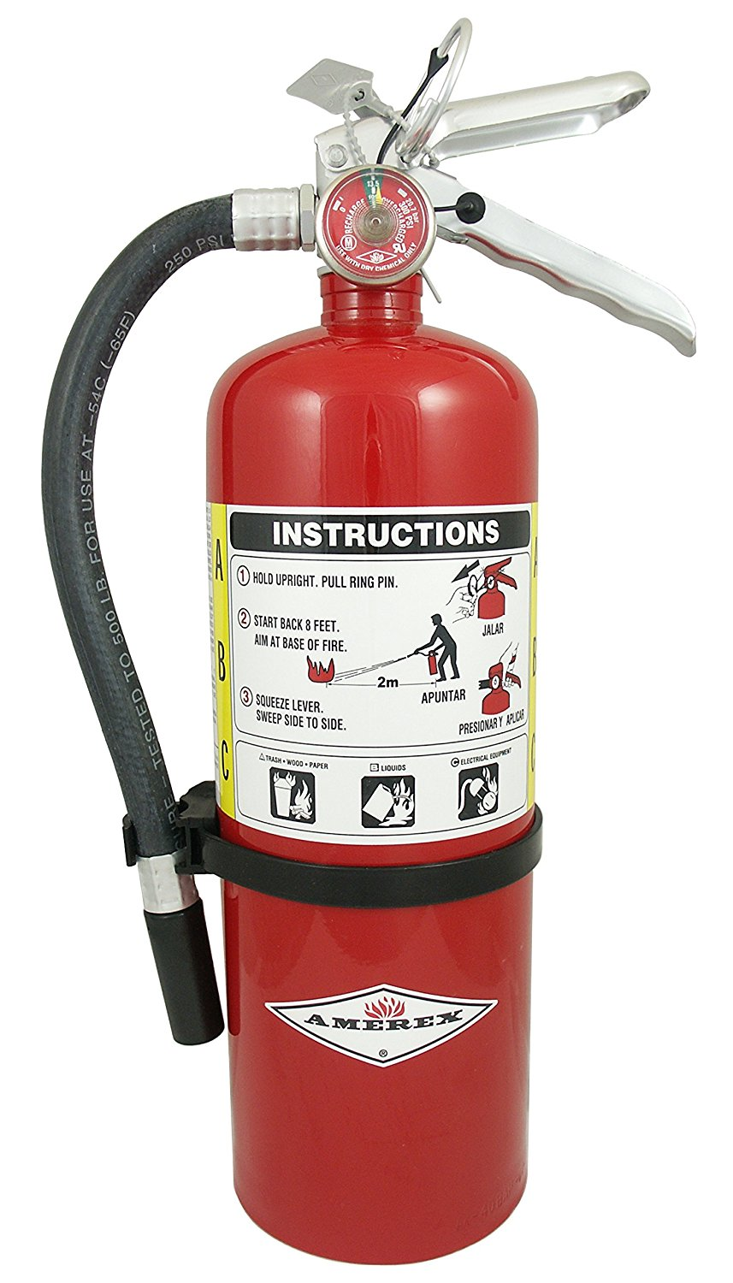
Possible solutions
Call for help from someone in your lab and turn on the emergency exhaust.
Move other flammables or electrical cords out of the way.
Try to smother the fire using sand or salt and the cap if possible.
Use the red class ABC fire extinguisher if the fire spreads or will not go out. Use the yellow class D extinguisher from the hallway if it is a pyrophoric metal.
If there is doubt the fire can be managed, close hood and pull fire alarm. Emergency gas shut off valves for the bay are near the exit/entrance.
Call EHS to properly dispose of the bottle, cleanup and replace a discharged extinguisher.
Notes:
Nitric oxide or nitrogen dioxide
Hydrogen disulfide

Slide 4
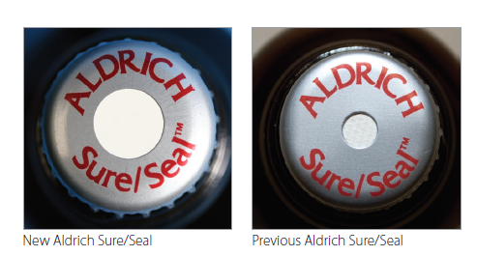
Preventative Measures
Always open pyrophoric materials slowly and carefully in the hood. Sigma-Aldrich bottles likely have protective air-free seals.
Don’t use an old degraded bottle of a reactive chemical or peroxide former. Dispose of properly as waste.
Notes:
Nitric oxide or nitrogen dioxide
Hydrogen disulfide

