Slide 1
Safety Moment
Asphyxiation hazards
This Photo by Unknown Author is licensed under CC BY-SA

Slide 2
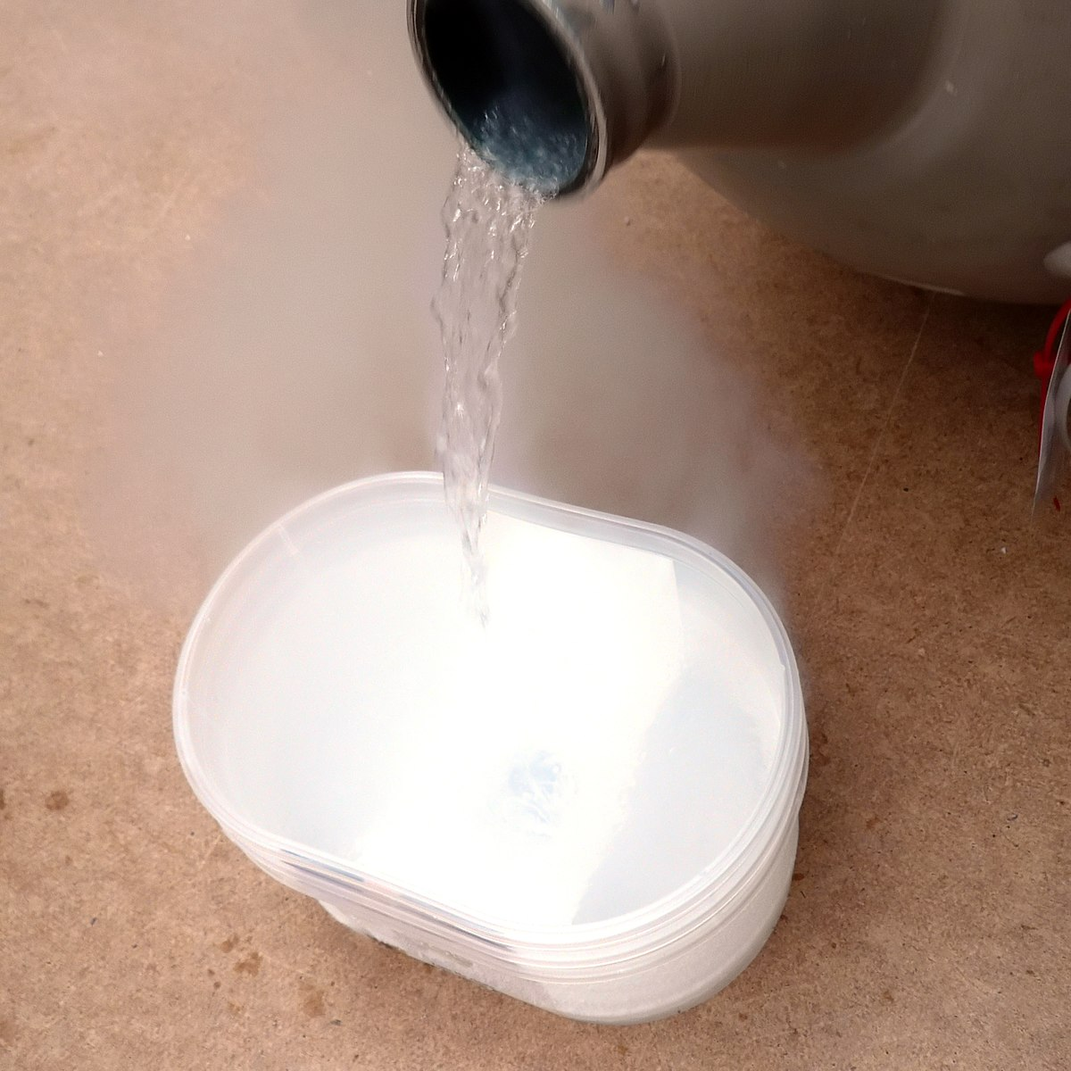
Safety Moment
1 L of N₂ (l) = 0.808 kg = 28.8 mol → PV = nRT → ~ 700 L gas!

Slide 3
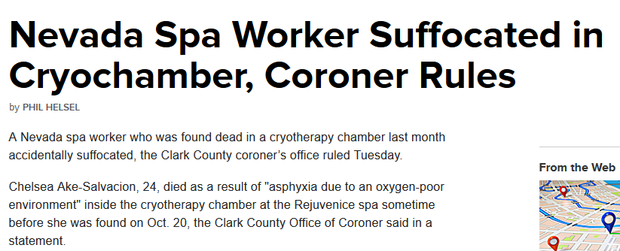
Safety Moment
…Ake-Salvacion was found crumpled at the bottom of the machine about the size of a phone booth. [She] had texted a friend about a possible nitrogen leak in the machine…
"Breathing air with this low level of oxygen can quickly result in unconsciousness and then death," the coroner's office said.
Referring to the deceased, Professor Hastie said: "This was a person who has worked daily with liquid nitrogen for years.”
https://www.telegraph.co.uk/news/worldnews/northamerica/usa/11987722/Coroner-finds-woman-who-died-trapped-inside-cryotherapy-chamber-suffocated.html
https://www.nbcnews.com/news/us-news/nevada-spa-worker-suffocated-cryochamber-coroner-rules-n461111
http://news.bbc.co.uk/2/hi/uk_news/scotland/484813.stm

Slide 4
Safety Moment
Dangers
Most gases are colorless and odorless
Make sure small spaces are well ventilated
Most people become unconscious at <10% O₂
Never take an elevator with full tanks of condensed gases.
Never transport compressed cylinders without caps.
Don’t assume other know what they are doing

