Slide 1
Safety Moment
Respiratory Protection

Slide 2
Respiratory Protection
Air Contaminants
Gasses
Vapor (gaseous liquid)
Dust (particles of a solid)
Fumes (condensed of volatile solids)
Mist (atomization of a liquid)
In selecting proper protection consider:
• Oxygen levels
• Form and concentration of contaminant
• Permissible Exposure Limits (PELs) from OSHA
https://www.osha.gov/dsg/annotated-pels/tablez-1.html
• Recommended Exposure Level (NIOSH)
https://www.cdc.gov/niosh/docs/87-116/
Consult your EHS department for help!

Slide 3
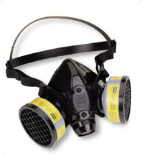
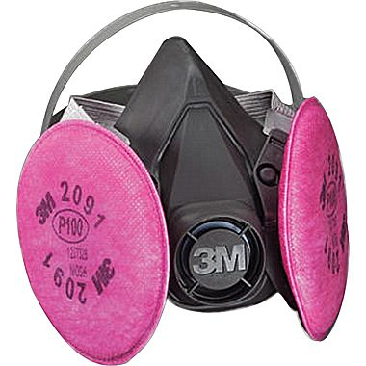
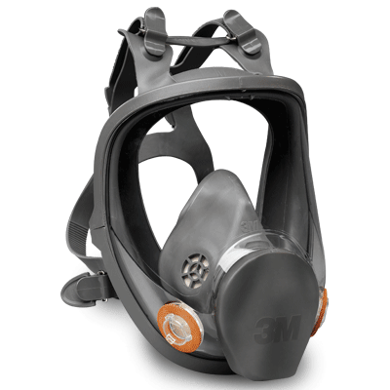
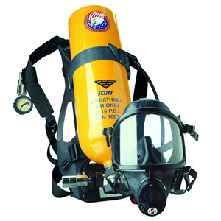
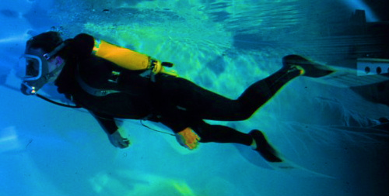
Types of Respirators
Air Purifying-Respirator (APR) –filters out specific contaminants by both mechanical (physical) and chemical means
Air-Suppling – Necessary for O₂ deficient environments
Half masks
Full face piece
Self-contained breathing apparatus (SCBA)
Self-contained underwater breathing apparatus (SCUBA)

