Slide 1
Safety Moment
Kitchen Hazards

Slide 2
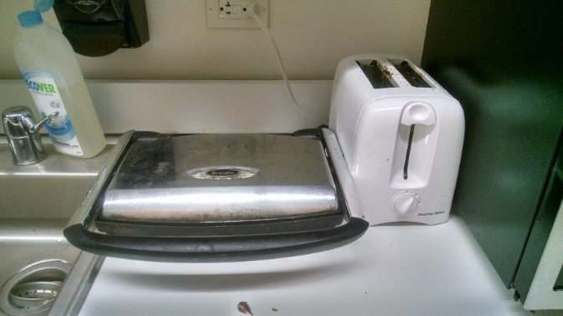
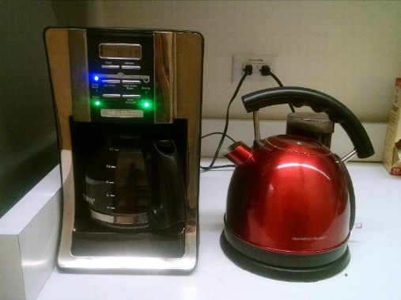
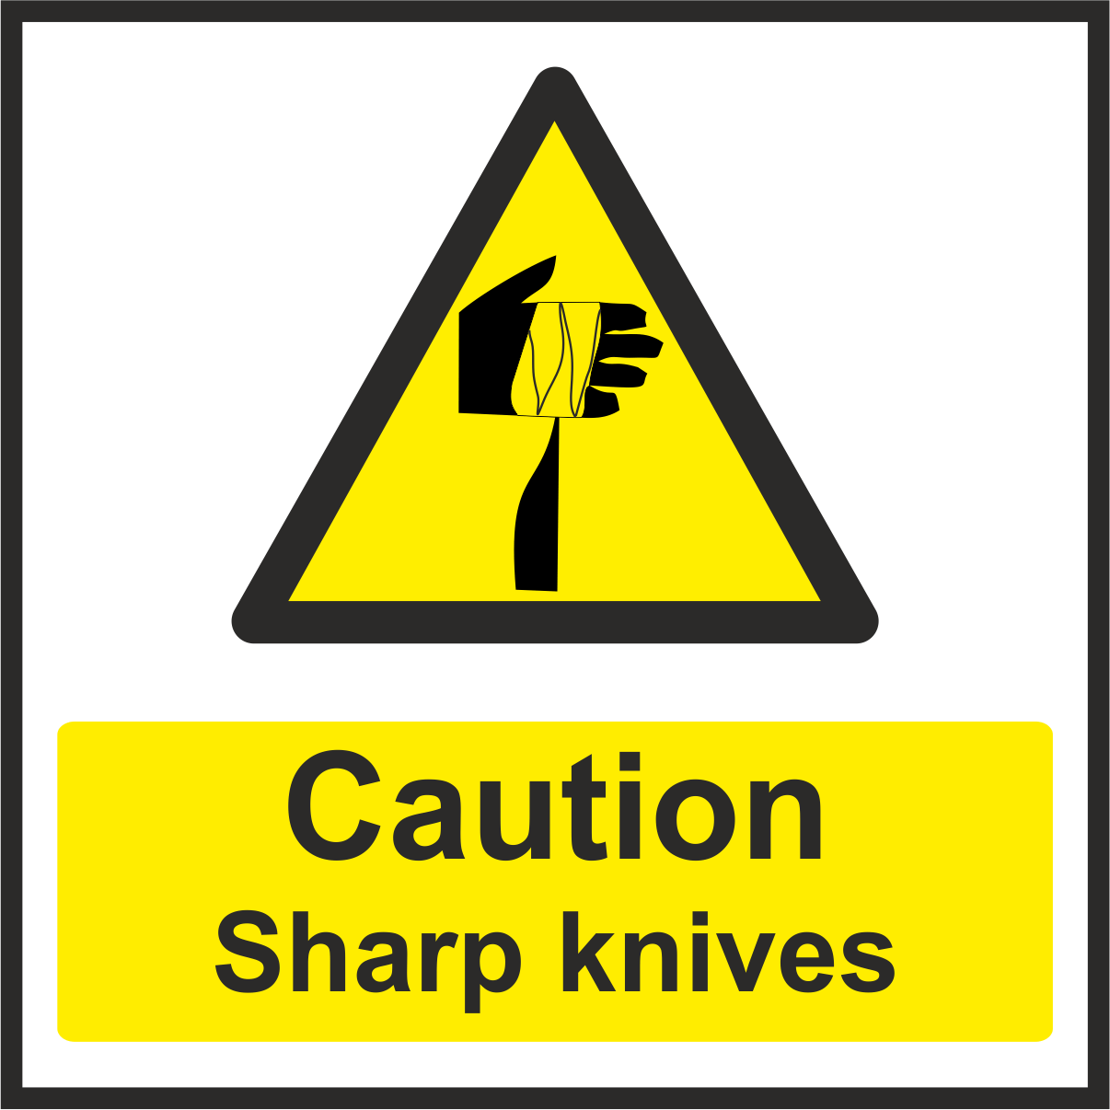
Safety Moment – Kitchen Hazards
Items with heating elements (toasters, panini press, toaster oven) retain heat even after being unplugged. Use caution when retrieving items from these appliances.
Clean out crumbs from toasters and toaster ovens regularly to prevent fires
Coffee pots and tea kettles make hot water (BP 100 ºC; 212 ºF ) which can cause serious burns to mouth/hands.
Knives should be used with caution on hard, flat surfaces. Make sure to keep fingers clear of blade.
Store sharp utensils like knives in a designated “sharps drawer” like in professional kitchens, so no ones is cut reaching into a random drawer.
Keep electrical cords and appliances away from sinks to prevent electrical shocks.

