Slide 1
Safety Moment
Vacuum Trap Safety

Slide 2
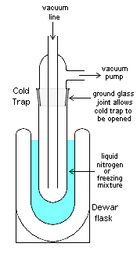
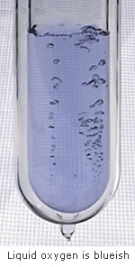
Safety Moment
Vacuum traps collect volatiles (typically solvents) used or produced in laboratory reactions to protect vacuum pumps from solvents
Usually cooled with dry ice and acetone (-78 °C) or liquid nitrogen (-196 °C)
Liquid nitrogen will freeze solvents and do the best job at protecting vacuum pump
Liquid N₂ can condense oxygen (BP -183 °C), argon (BP -186 °C), and other condensable gases
Be careful not to leave vacuum trap open to atmosphere for extended periods of time
Autoxidation occurs with liquid oxygen. Explosions can occur with organic materials, as warming up, as a result of shock…
If you notice a condensed gas in your vacuum trap, clear the area of any flammables, remove the Dewar flask, and open the vent valve to let the liquid boil off slowly. Alert others to the danger and clear the area.

