Slide 1
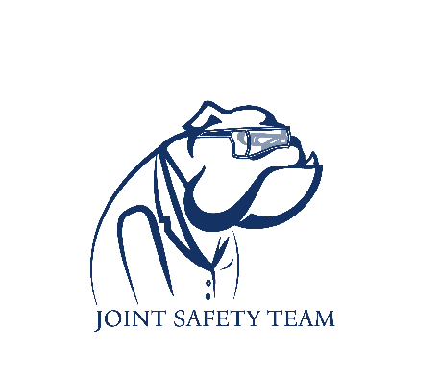
Syringe accident
Safety scenario

Slide 2
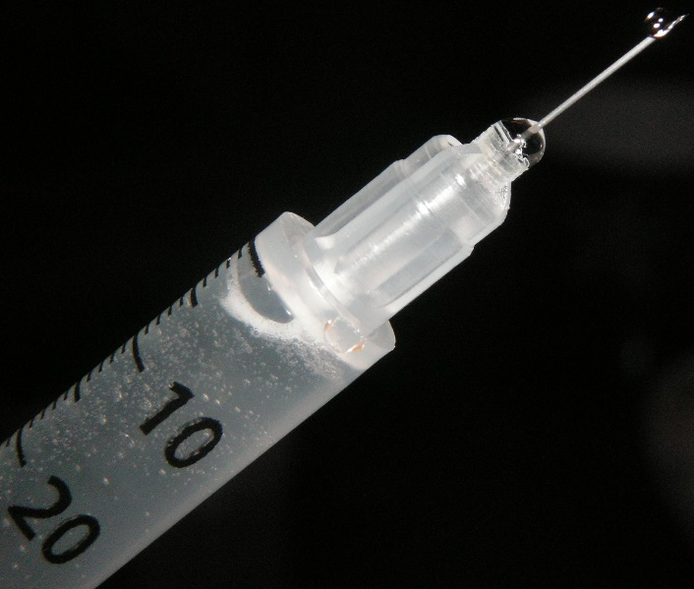
Scenario
You are about to add a large volume of solvent via syringe to a reaction. The syringe is overfilled and the pressure from the nitrogen line pops the plunger out splashing some under your goggles into your eye. How do you respond?
Notes:
Nitric oxide or nitrogen dioxide
Hydrogen disulfide

Slide 3
Possible solutions
Call for a lab mate to help you and remove any contaminated clothing.
Use the eyewash station holding your eyes open while flushing with water for 15 min.
Get someone to look up the (M)SDS sheet.
After full decontamination, you can visit Yale acute care with the (M)SDS sheet to treat any injury.
Notes:
Nitric oxide or nitrogen dioxide
Hydrogen disulfide

Slide 4
Preventative measures
Never overfill a syringe.
Do not use high pressure on nitrogen lines going into a reaction or reagent bottle. Use a balloon instead.
Always hold the syringe tightly at the back and at the needle connection with one hand.
Notes:
Nitric oxide or nitrogen dioxide
Hydrogen disulfide

