Slide 1
Distillation
Safety scenario

Slide 2
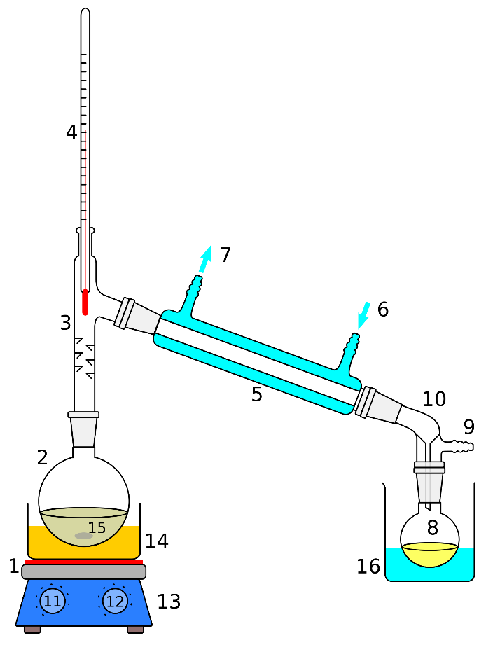
Scenario
You are distilling a large volume of an amine base in your hood when the round bottom flask cracks at the bottom and starts leaking. You begin smelling the amine. What should you do next?
Notes:
Nitric oxide or nitrogen dioxide
Hydrogen disulfide

Slide 3
Possible solutions
Unplug and remove the heat source. Try to contain the material.
Turn on emergency exhaust and close the hood sashes.
Turn off vacuum and move reactive chemicals from the immediate area.
Alert people to evacuate the area and block off the entrance. Use a sign like the JST’s provided “Chemical Spill: Do Not Enter” sign.
If the spill is large contact EHS to clean up the spill and refer to the (M)SDS sheet for proper cleanup, neutralization, disposal and exposure responses as needed.
Notes:
Nitric oxide or nitrogen dioxide
Hydrogen disulfide

Slide 4
Preventative measures
Check round bottoms for star cracks before using especially when heating or under vacuum/pressure.
Ensure proper stirring and keep flask from touching the bottom of the bath to prevent overheating at a single spot.
Do not boil to dryness.
Notes:
Nitric oxide or nitrogen dioxide
Hydrogen disulfide

