Slide 1
SELF DEFENSE 1 TECHNIQUES (short program)
Instructed by: Craig Elkin
Assisted by: Carolyn Rinaldi

Slide 2
Important note:
The following techniques are to be used as a reminder of the moves learned
during a six week seminar. They are not a replacement for attending the seminar,
nor are they meant to be detailed explanations.
As in all self defense, techniques must become second nature.
Preparation and training is key to a successful outcome.

Slide 3
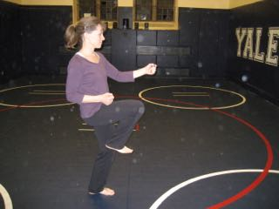
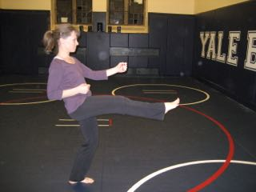
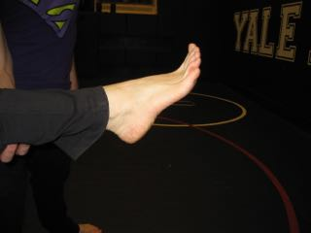
Front Kick
Lift knee (think about kicking over a bar)
Keep center of gravity forward, body upright
Extend leg and kick with the ball of your foot
Snap back your foot to the starting position

Slide 4
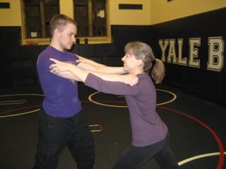
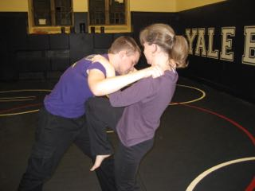
Scenario #2: TWO-HANDED GRAB FROM FRONT
1.Attacker grabs from the front
2. Grab them back and pull them downward while attacking with your knee

Slide 5
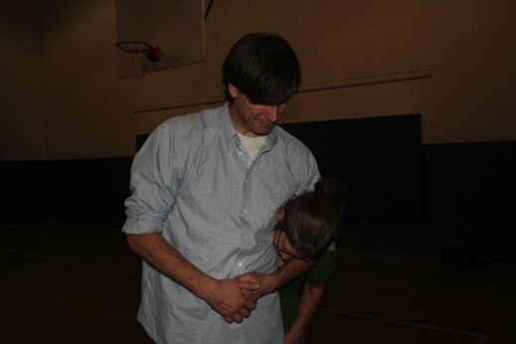
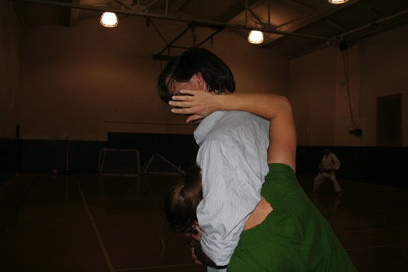
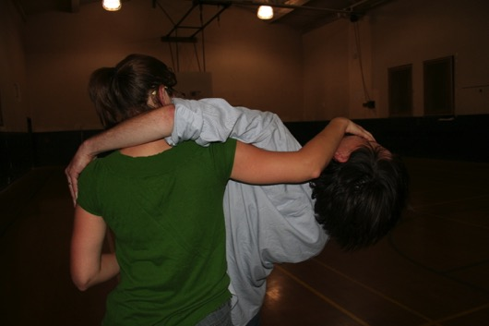
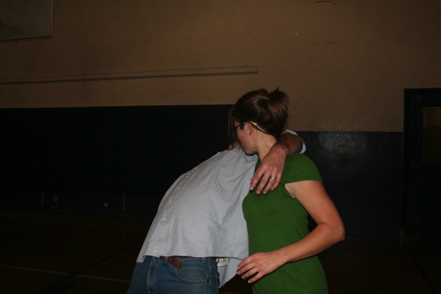
Scenario #3: HEADLOCK
Attacker grabs around neck. Tuck your
Tuck your head to avoid punches to the face
2. Raise your inside arm behind the attacker’s
back
3. Grab the attacker’s face—ideally the nose
4. Pull your arm down and around while you turn
And stand up

