Slide 1
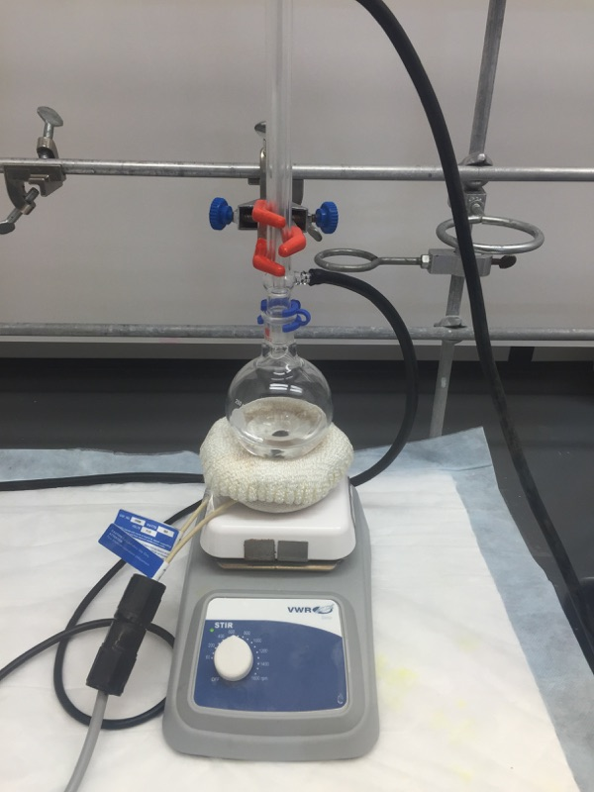
Safety Scenario
You are running a reaction which requires heating at reflux overnight.
As you come back the next morning, you notice the cooling water tube had turned black at a spot where it made contact with the heating plate.
What could have happened?!
How could this hazard have been avoided?
1

Slide 2
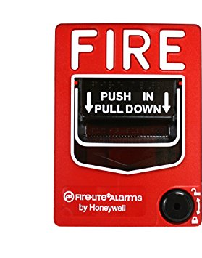
Safety Scenario
You’re in the middle of quenching a 12 g ligand synthesis and the fire alarm goes off.
What should you do?
2
Notes:
Nitrogen essential to all life; constitutes amino acids, DNA, etc.
N2 not bio-available

Slide 3
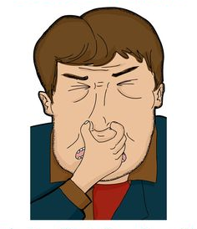
Safety Scenario
You smell something in the lab one day, and it definitely does not smell good.
Should I figure what the chemical is?
Should I identify the origin of smell?
How do we avoid these situations in the future?
General safety measures:
Alert co-workers and evacuate the area
Call EHS

Slide 4
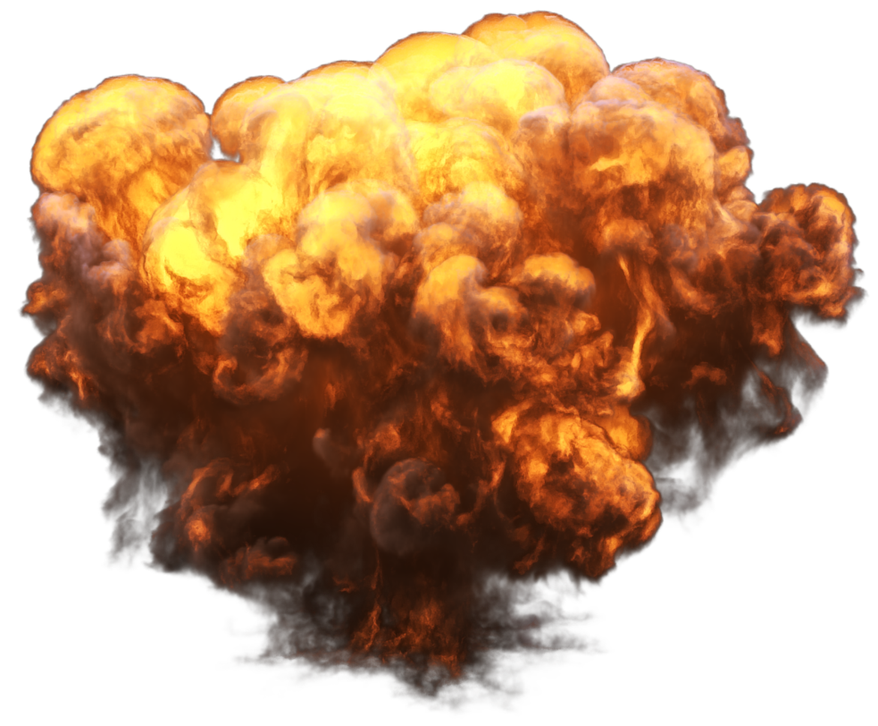
Safety Scenario
A 4 L container without a vented cap in the waste hood explodes hitting a lab member as he is washing NMR tubes. What do you do?
Response:
Get student under the safety shower
Call EHS & alert lab members
Close off the area
Wait for EHS/Hazmat to arrive
Preventative Measures:
Neutralize any hazardous waste prior to mixing in the larger containers
Not closing the unvented cap tightly

Slide 5
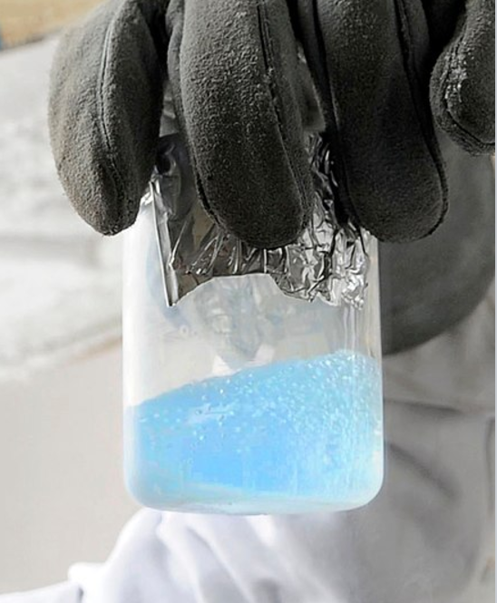
What Should be Done in the Following Situation?
Safety Scenario
After a tired day of work in lab, you decide to take off and take down your Schlenk line. However, you find this mysterious blue liquid collected in your trap—what should you do?
Dangers of liquid oxygen in the trap: It is highly explosive in the presence of organic compounds (especially grease)
Solution: Put a blast shield around the trap and let it slowly warm up to r.t. Also warn others.
https://en.wikipedia.org/wiki/Liquid_oxygen.

Slide 6
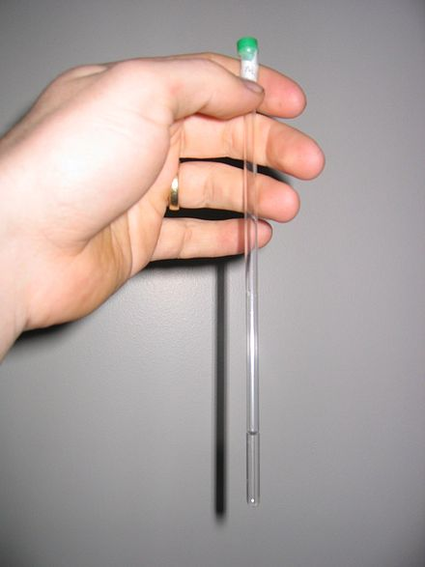
Safety Moment
Preventing Contamination from NMR Tubes
NMR tubes should be placed in a small container when you go downstairs (especially when you have more than one sample!)
Before putting the samples into the container, you should wipe them with kimwipes to remove any chemicals on them.
Avoid going through the offices with samples—use the other door at the end.
Insert and remove NMR tubes carefully from spinners to avoid breaking the tube

Slide 7
Safety Moment - Pyrophoric Compounds
“A pyrophoric substance ignites spontaneously in air at or below 55 °C (130 °F)”
Do not bring porous materials such as cardboard or non-dried glass into the glove box.
After cleaning up a potentially pyrophoric spill of a solid or liquid form the glove box – be aware that as you bring contaminated materials out they may react and or catch fire in air!
Utilize plastic bags to contain contaminated kim-wipes/paper towels in the inert atmosphere of the glove box before bringing them out.

Slide 8
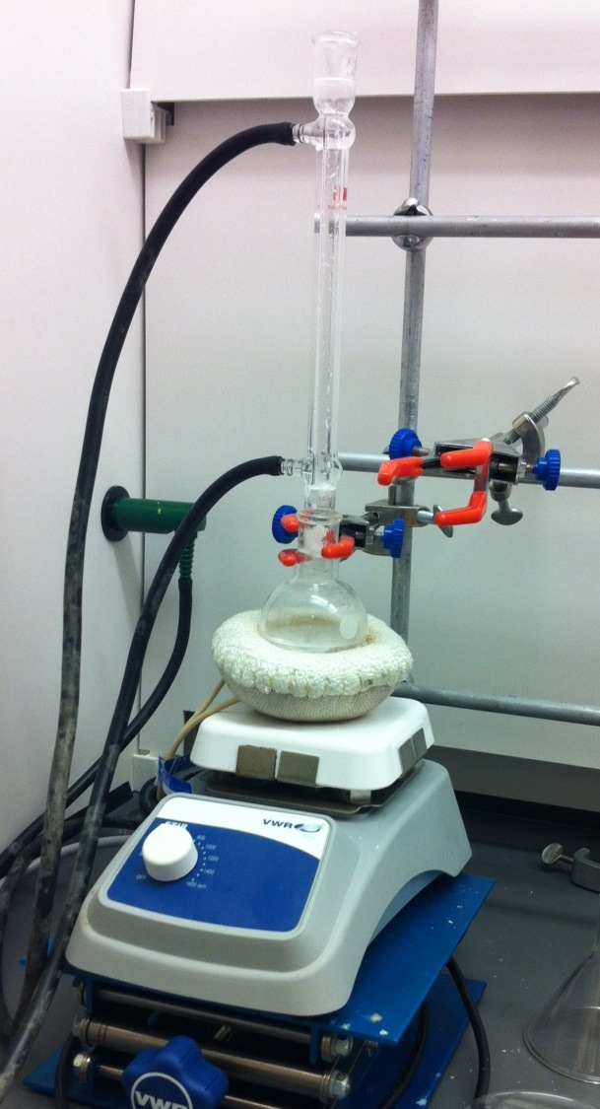
Safety Scenario
Daniel is setting up a reaction to reflux in toluene. John is pestering him to get lunch and he’s hungry so he sets the temperature of the hot plate to 120 °C and leaves. He doesn’t fill out a reaction card or label the reaction since he’s planning to come right back. Sean walks past his hood 10 minutes later and sees smoke.
What should Sean do?

Slide 9
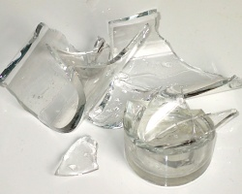
Safety Scenario
While you are washing a flask, it shatters, sending pieces of glass into your hand.
What should you do?
Further questions:
Did the flask contain reagents?
Is glass embedded in your skin?

Slide 10
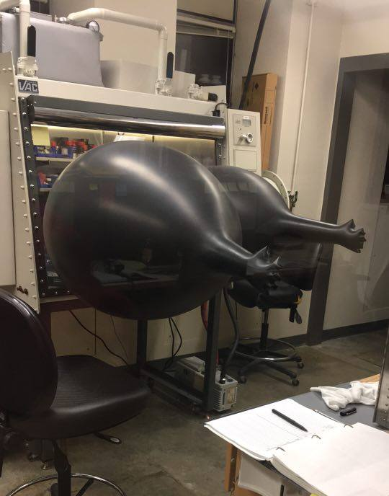
Safety Scenario
You walk into lab and see this at the glove box.
What should you do?
How can you try and resolve the situation?
(Opening the anti-chamber on the outside could help prevent an explosion!)

Slide 11
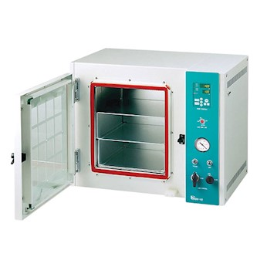
Safety Scenario
Stacy wants to heat a metal complex in the vacuum oven overnight in order to drive off any residual water before bringing it into the glovebox. She puts the complex on a watch glass and sets the oven to 120 °C under dynamic vacuum and leaves it for 24 hours.
She comes back the next day to discover that her compound has decomposed, and white/yellow crystals have sublimed all over the vacuum oven. What should she do?

