Slide 1
Synthetic Clothing and Fires

Slide 2
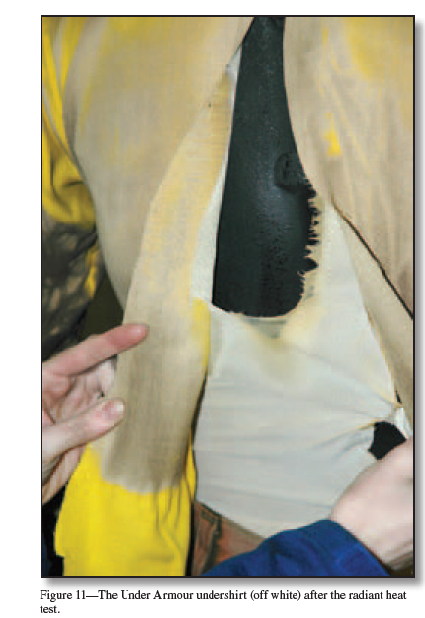
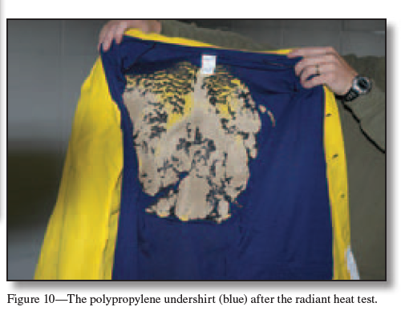
Para-aramid related to Kevlar
Polyester
Nylon
Fireproof lab coats are meant to conduct and dissipate heat without burning or melting.
Made from aramid, heat-resistant, strong synthetic and anti-static fibers
Synthetic garments pose a high burn risk even under a fireproof lab coat – nylon, polyester, acrylic, rayon, spandex
Ignite and burn quickly, melt/drip, produce black smoke and harsh odors. Leaves hardened plastic residue.
Transfer heat to skin rapidly increasing burns.
Natural fibers – Cotton and hemp (cellulose). Wool and silk (proteins).
Harder to ignite and do not melt.
100% cotton and wool worn by firefighters under suits.
Petrilli, Tony, and Mark Ackerman. “Tests of Undergarments Exposed to Fire.” United States Forest Service, USDA, Dec. 2008, www.fs.fed.us/t-d/pubs/htmlpubs/htm08512348/index.htm.

