Slide 1
Incompatible Chemicals
Chemical Storage
Merck chemical company.
Chemical Safety Office, Risk Management Department, University of Vermont
Hazards in the Chemical Laboratory, 4th. edition. 1986. Bretherick.
Manufacturing Chemist’s Association, Guide for Safety in the Chemical laboratory, (UNH website)

Slide 2
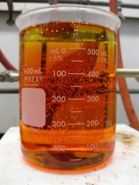
Class: Acids
Acetic Acids - HNO₃, MnO₄⁻, ROHs, NH₄NO₃, ROOR → potentially explosive peroxides
Use a blast shield if generating peroxy acetic acid for a reaction
HNO₃ - CrO₃, CaCO₃, AcOAc, AcOH, organic materials (carbonyl compounds, aromatic compounds, bases)
can react violently generating gasses and explode especially in a sealed container
do not use aqua regia to remove these compounds
H₂SO₄ - ClO₃⁻, ClO₄⁻, MnO₄⁻ → oxo acids decompose rapidly, react violently, and accelerate fires
Bubbling Aqua Regia

Slide 3
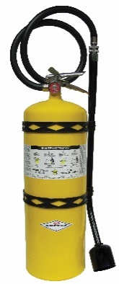
Class: Metals
Exposure to H₂ gas may explode/catch fire in air
eg. Palladium on Carbon
Store air and water free
Alkali Metals - O₂, halo-alkanes, H⁺, ROHs, halogens (Br₂), H₂O
use a yellow class D fire extinguisher
Al/Zn - H₂O, Ox, ROOR, halo-alkanes, H⁺ and bases
keep out of base bath!
Aluminum metal plus hydroxide bases generates H₂ gas
Class D pyrophoric metals fire extinguisher

Slide 4
Class: Organics
Acetaldehyde - AcOH, AcOAc → exothermic polymerization reactions possible
Acetone - HNO₃, H₂SO₄, H₂O₂ → acetone peroxide is highly unstable and explosive
keep strong acids out of acetone waste
Anilines - HNO₃, H₂O₂ → trinitroaniline is strongly oxidizing and explosive similar to picric acid and TNT
Acetone peroxide monomer

Slide 5
Class: Non-metal inorganics
Br₂/Cl₂ - butadiene, benzene, metals, reductants → can spontaneously ignite flammable materials
store in a cool, well ventilated, dark place away from metals (fridge in secondary containment)
Phosphorous - Ox, oxygen and sulfur compounds → P₂O₅/P₄O₁₀ and H₂O react violently to produce phosphoric acid
PR₃ burns spontaneously with oxoacids
store air and water free
Peroxides - H⁺, AcOAc, NH₃, metals → violent explosion with PbOx and PbSx
avoid shock, store in cold dark place
Hydroscopic
Highly unstable

Slide 6
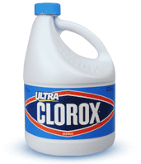
Class: Non-metal inorganics
Nitrates/Nitrites/(Per)Chlorates - H⁺, reductants, NH₄⁺ →
NH₄NO₃ is highly explosive
NH₄ClO₄ explodes upon heating
Hydrazines - Ox →highly exothermic N₂ production
Keep damp in aq. solutions
Unstable to heat and shock when dry!
Azides - H⁺, CS₂, heavy metals → Pb(N₃)₂ is a shock sensitive
HN₃ is a volatile and highly toxic explosive
Cyanides - H⁺ → toxic HCN gas!
Store away from acids, maintain basic solutions
Sodium Hypochlorite (Bleach) - NR₃, ROHs, acetone, H₂O₂, H⁺ → produces flammable and noxious gasses
Cl₂, HClO, O₂

